Slide 1
CSC 101 Applied Physics Spring 2023
Dr. Syed Irfan Sohail

Slide 2
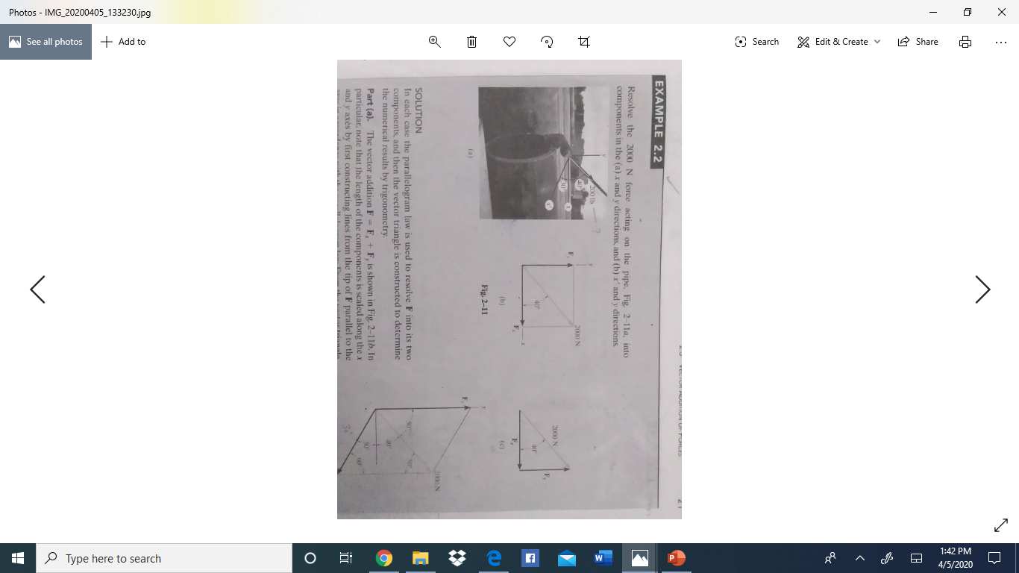
Example Problem: 2.2/page 21 of 11th edition

Slide 3
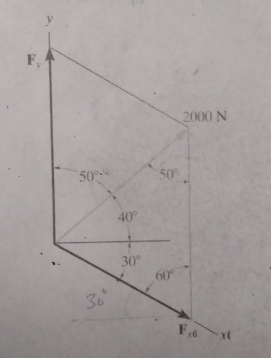
Example Problem: 2.2/page 21 of 11th edition

Slide 4
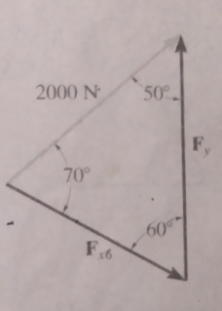
Example Problem: 2.2/page 21 of 11th edition

Slide 5
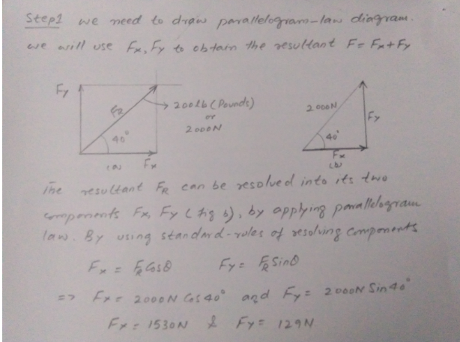

Slide 6
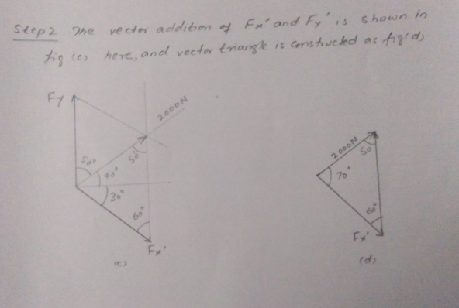

Slide 7
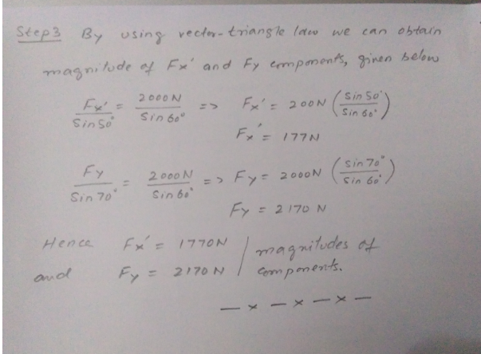

Slide 8
